Slide 1
Cottage Connect
Deliverable #1
Team: Brett Fuller, Conrad Harrison, Kim Kaufman and David Staas

Slide 2
Overview
Most small business owners do not have the time, money or skill to advertise their product on the internet. Their business depends on word of mouth and weekends at the Farmers Market. Most people would support local small businesses, if they knew they existed. Cottage Connect is the conduit that lets small business owners advertise with just a few clicks of the keyboard and allows customers to discover what is in their area.

Slide 3
Design

Slide 4
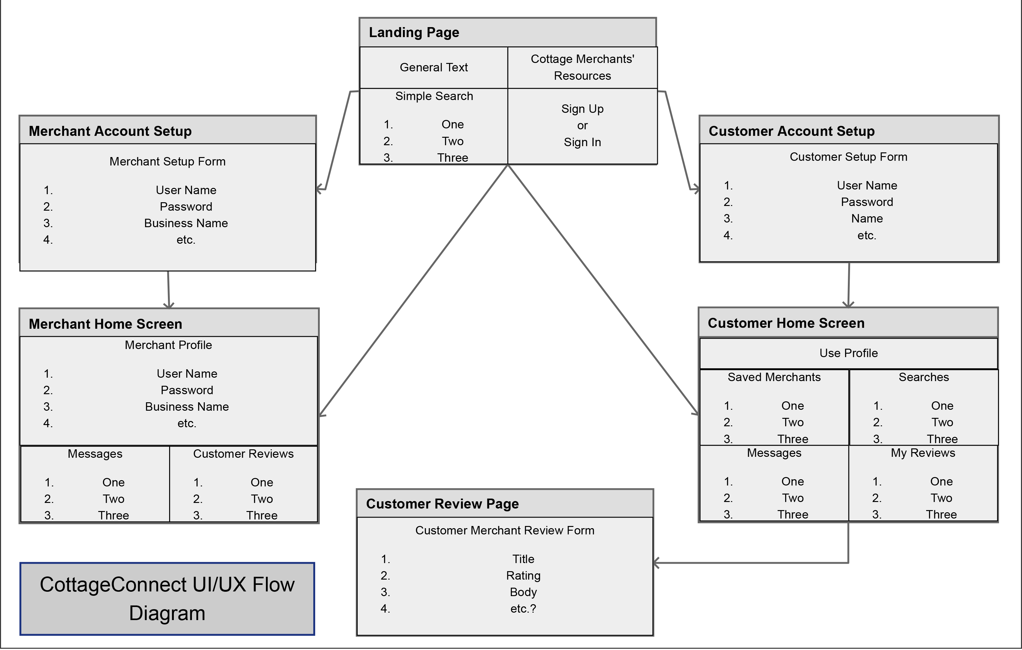

Slide 5
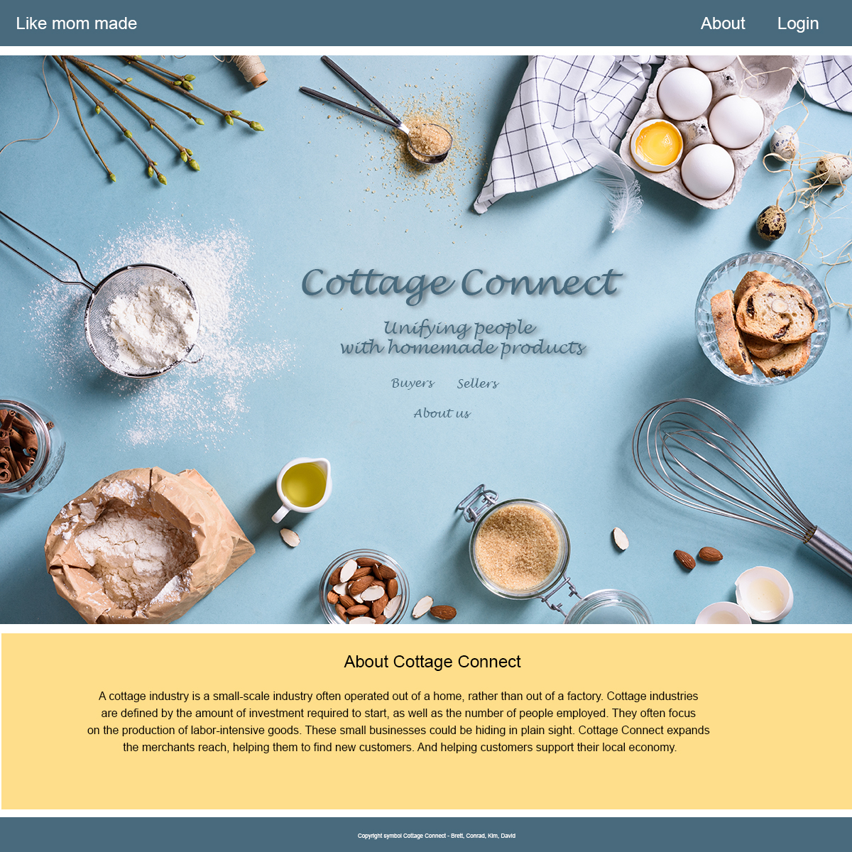
Landing page

Slide 6
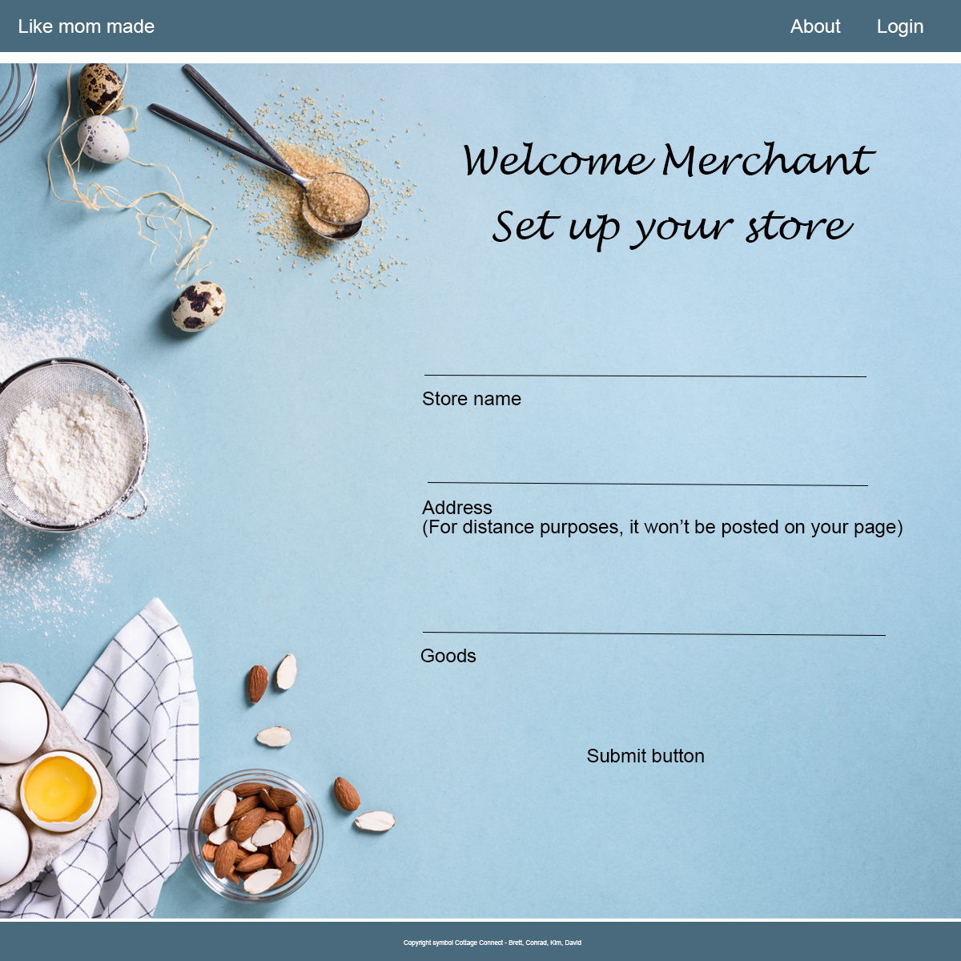
Page for merchant to set up the basics about their store

Slide 7
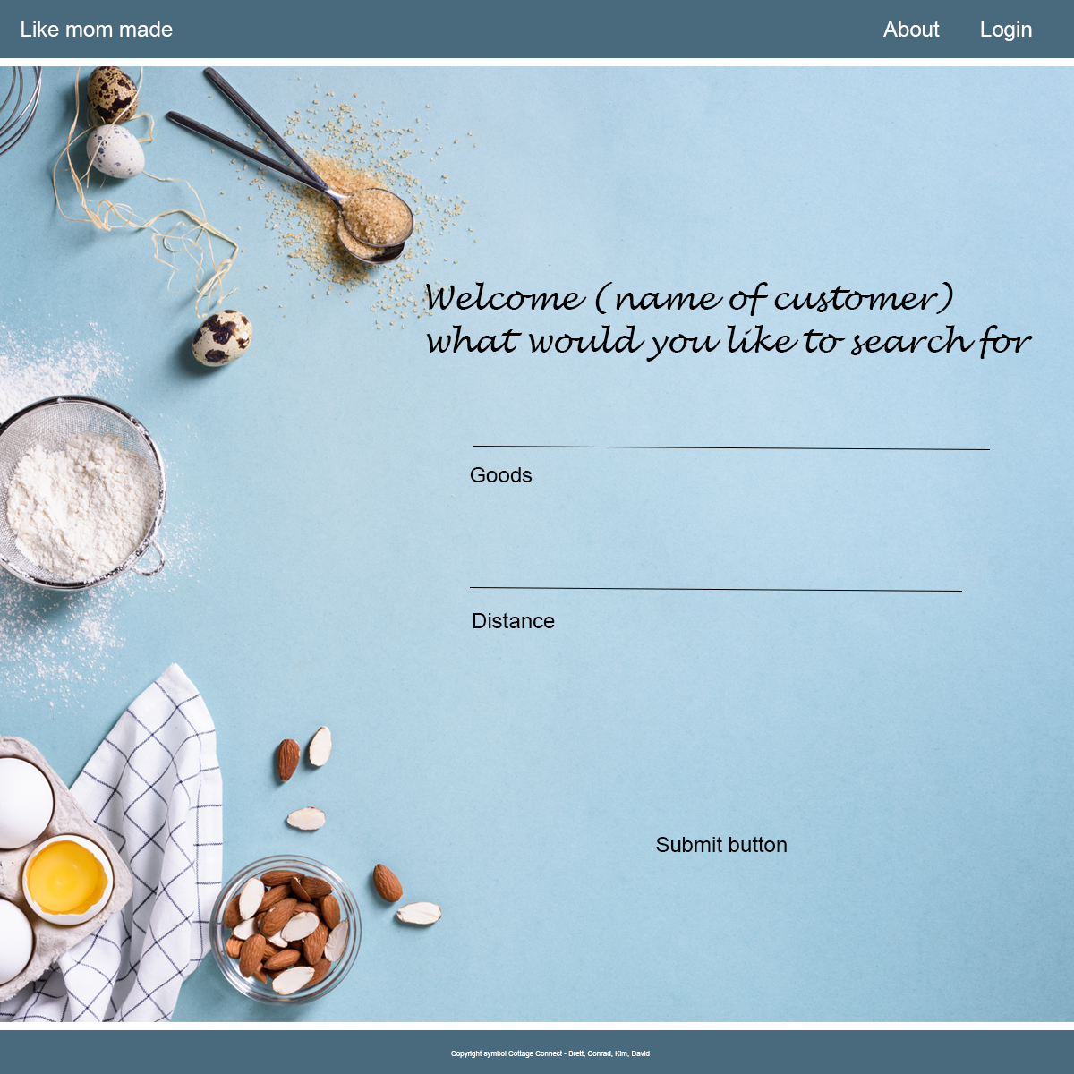
Search page for customer

Slide 8
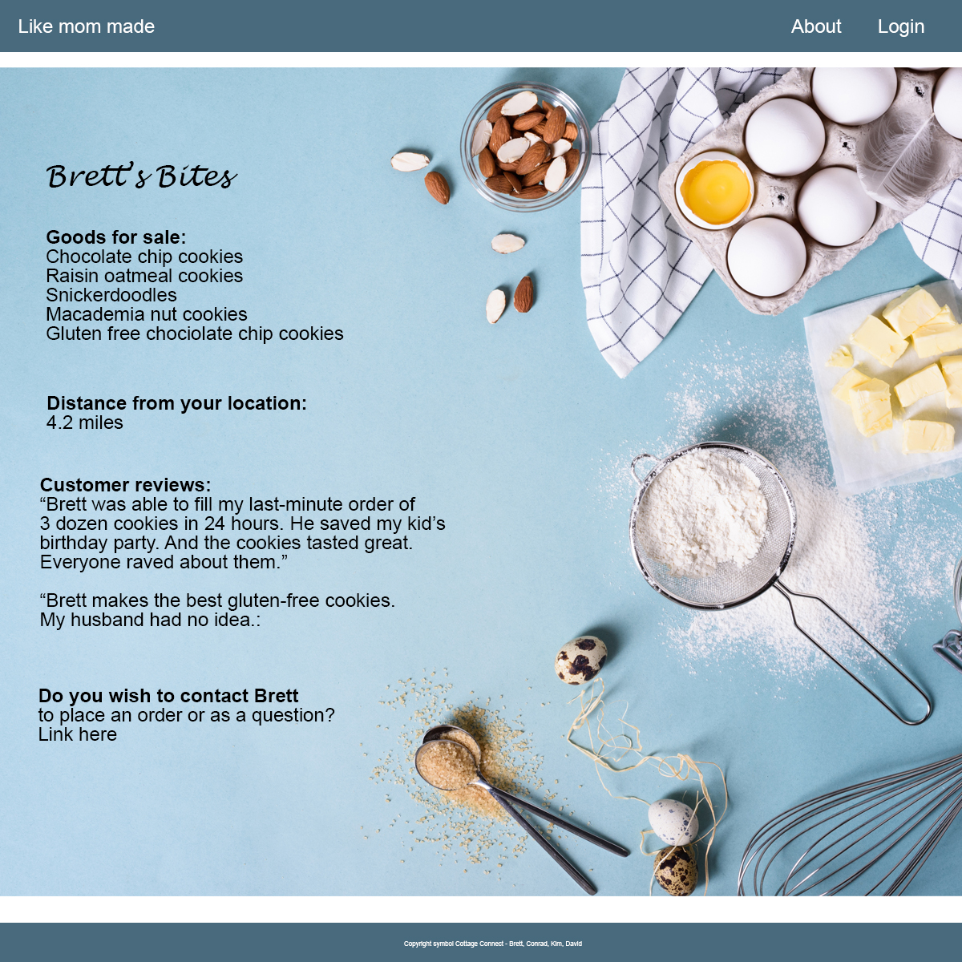
Merchant’s home page

Slide 9
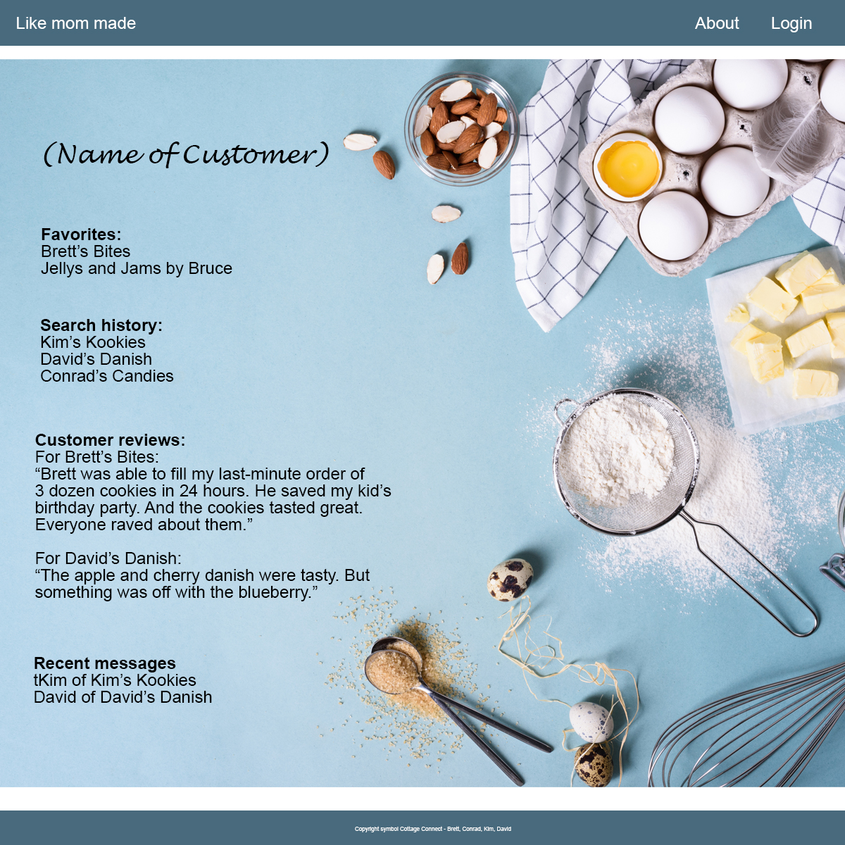
Customer page

Slide 10
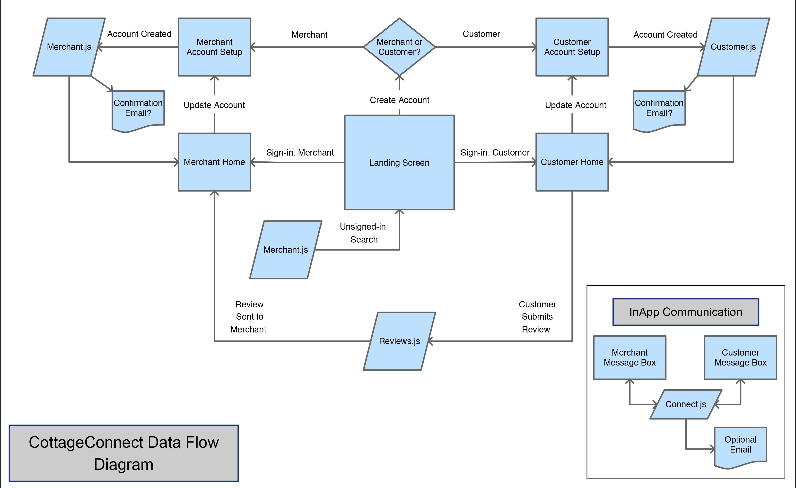

Slide 11
Breakdown of roles
Brett: React, client-side routes and Heroku deployment
Conrad: Node packages, APIs and authentication
Kim: React, file structuring and styling
David: Database and server-side routes

Slide 12
Schedule of tasks
Database set up: Dec. 27
Landing page complete: Dec. 29
Node packages/APIs running: Dec. 30
Project deployed to Heroku: Jan. 2
Authentication complete: Jan. 3
Routing complete: Jan. 8

Slide 13
Project Management
GitHub

Slide 14
